Slide 1
Brief Introduction of SocketPro Async Communication Framework
Continuous Request Sending, Processing and Returning for the Best Network Efficiency and Throughput
Yuancai (Charlie) Ye

Slide 2
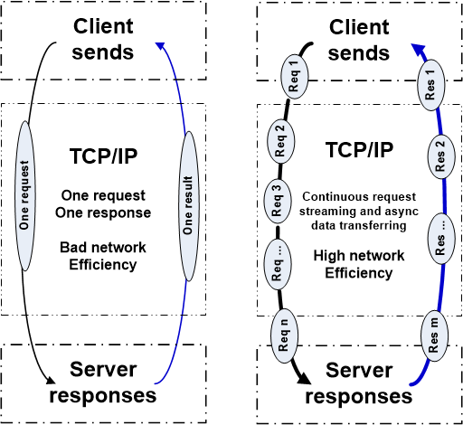
Two Basic Communication Patterns

Slide 3
Advantages and Disadvantages
SCF (Synchronous Communication Frameworks) | ACF (Asynchronous Communication Frameworks)
Good for typical applications Easy to get started Many free SCFs available Good for Local Area Networks (LAN) Simple in coding logic and better code readability Easy in debugging | Great for high-quality applications Great for challenging tasks Multiple communication models integrated Great for both LAN and WAN Great performance, UI response and scalability because of streaming & batching Great for both fat and thin clients Less threading-related problems Better user-code consistence
Bad for high-quality applications Bad for challenging tasks One communication model only Bad for Wide Area Networks (WAN) Bad performance, latency and UI response No dev/design freedom Many threading-related problems Bad scalability | Fewer high quality ACFs available Slightly more complex in coding logic and readability Slightly more difficult in debugging Difficult to create an ACF

Slide 4
SocketPro Communication Architecture and Components
Client Core
cross-platform
native code
Server Core
cross-platform
native code
Request batching and streaming, asynchrony, secure, parallel communication on TCP/IP
C++
Adapter
.Net
Adapter
Java
Adapter
Python
Adapter
JavaScript
Adapter
PHP
Adapter
Node.js
Adapter
C++
Adapter
.Net
Adapter
Python
Adapter
Java
Adapter
User Client Code
User Server Code

Slide 5
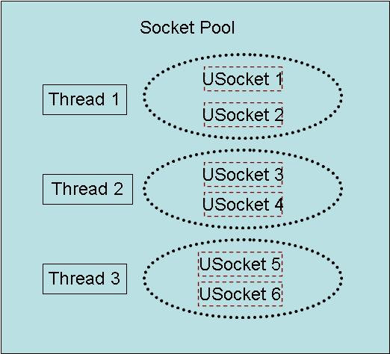
Client Socket Pool
A socket pool has three worker threads and each of these threads hosts two non-blocking sockets with fault tolerance for the best parallelism

Slide 6
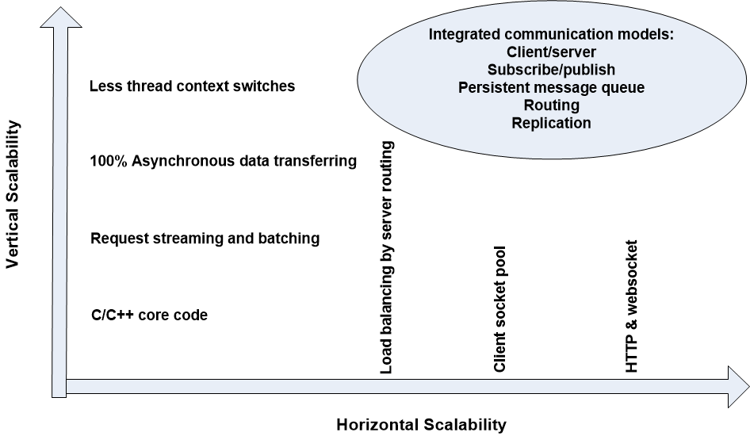
SocketPro Scalabilities

Slide 7
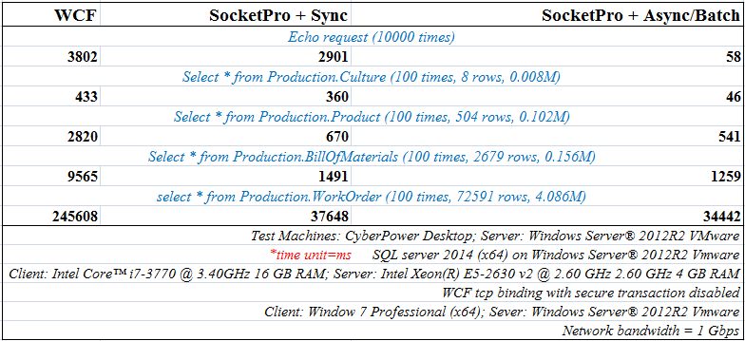
Client/Server Pattern

Slide 8
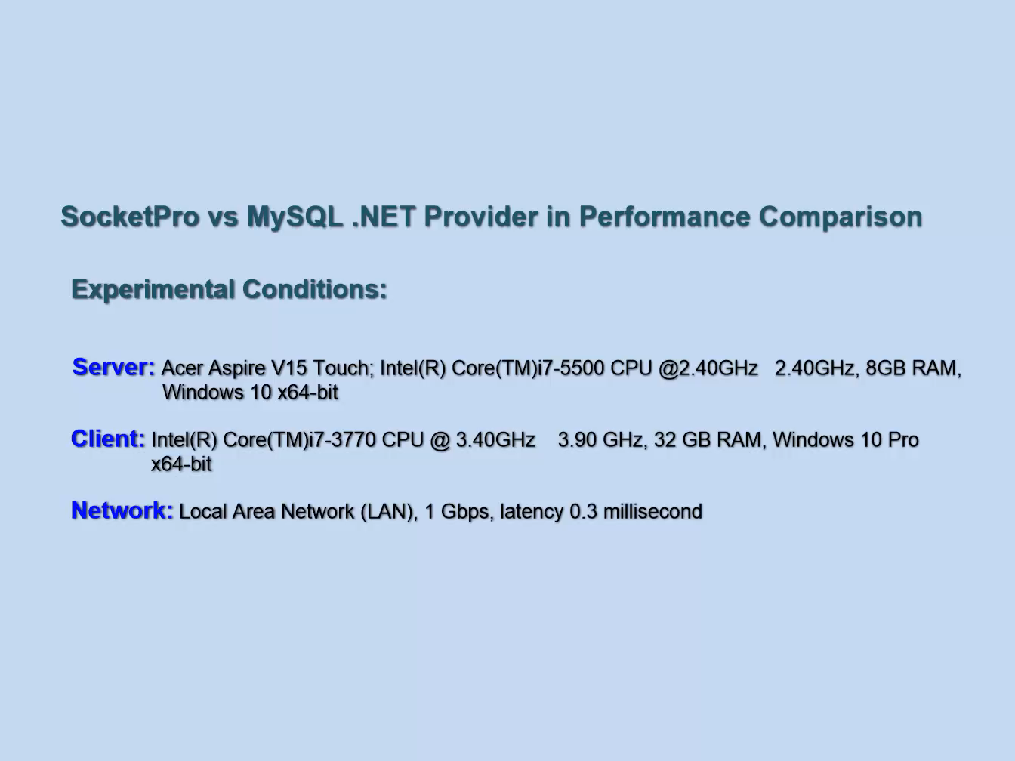
SocketPro vs MySQL .NET Provider (LAN)

Slide 9
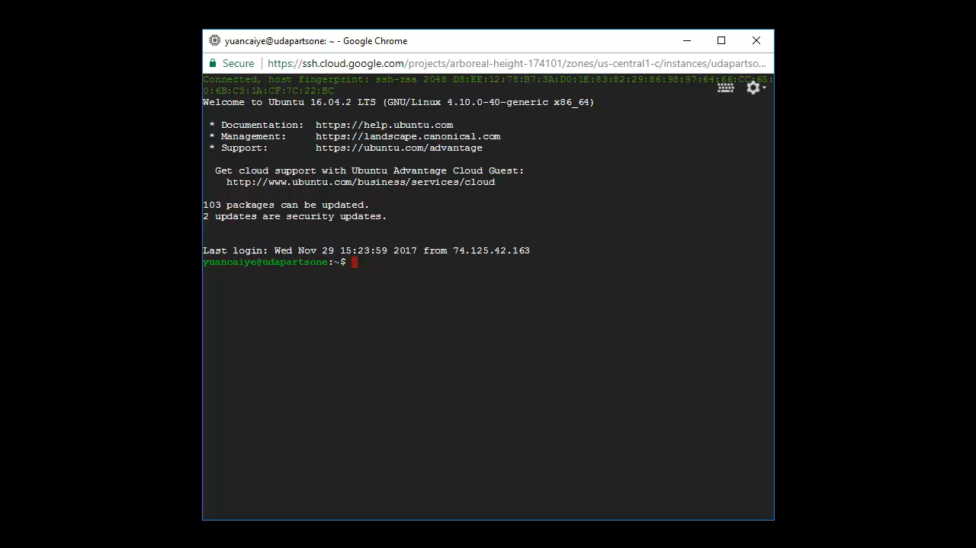
SocketPro vs MySQL .NET Provider (WAN)

Slide 10
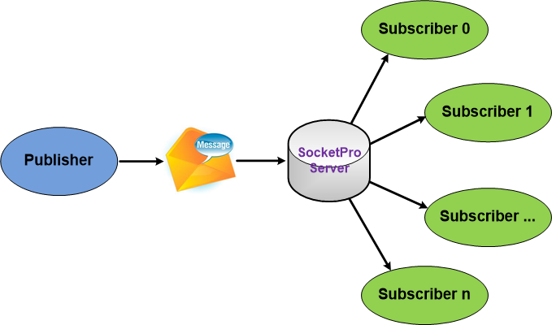
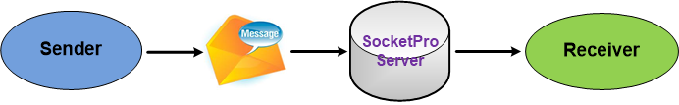
SocketPro Subscribe/Publish (Internet chat or online messaging)

Slide 11
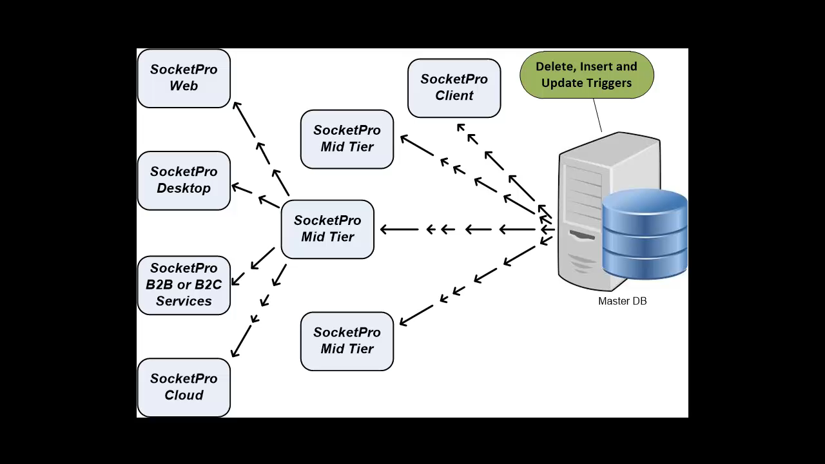
SocketPro for DB Events

Slide 12
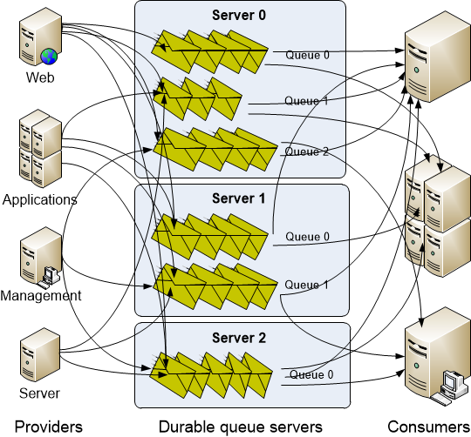
SocketPro Persistent Message Queue
Advantages of SocketPro over Kafka:
Manual transaction
Queue sharable among multiple consumers
Real-time message availability event (low latency)
No configuration settings
Faster than Kafka in message writing
Select a portion of requests to be queued persistently
No message loss as messages can be backed up at provider side

Slide 13
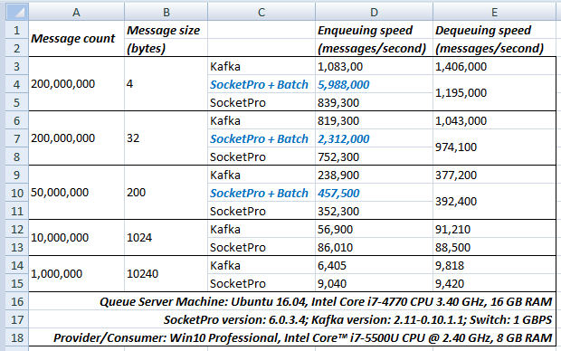
Performance Comparison between SocketPro Persistent Queue and Kafka

Slide 14
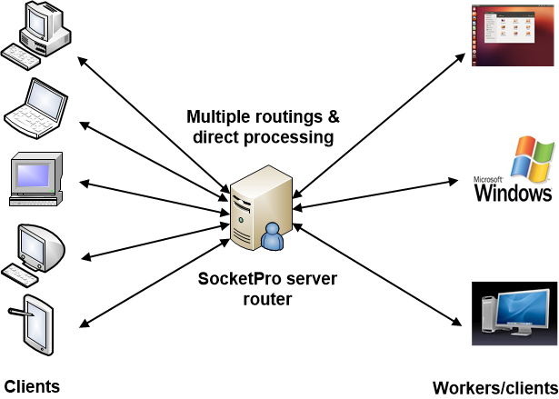
SocketPro Server Requests Routing for Loading Balance with Fault Tolerance

Slide 15
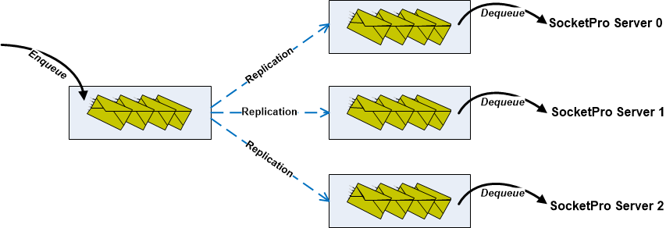
SocketPro Replication with ACID (Atomicity, Consistency, Isolation, Durability)

Slide 16
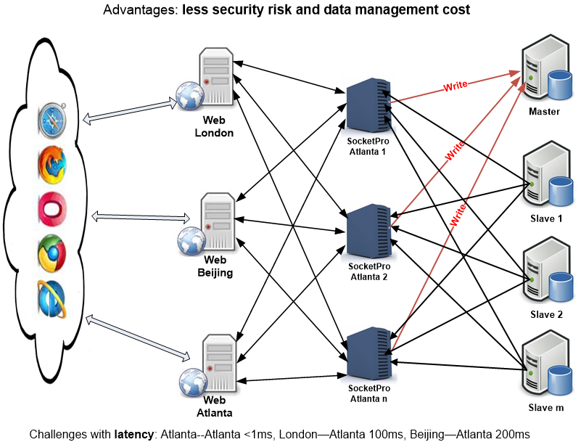
Enterprise Master/Slave Distributed Systems by SocketPro

Slide 17
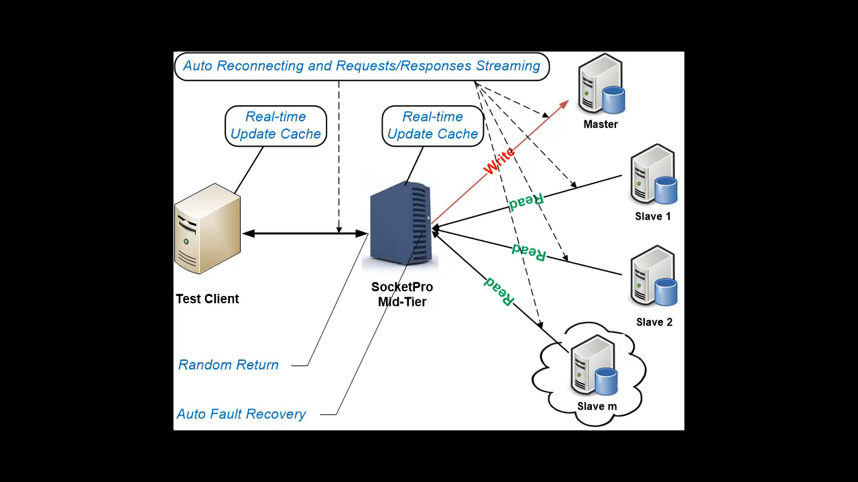
Master/Slave Pools for Enterprise Applications (Real-time Cache and SQL/Request Streaming)

Slide 18
SocketPro Plugins
Persistent Message Queue
Cross-platform File Exchange (TBD)
Database Plugins
SQLite (Real-time Update Cache)
MySQL (Real-time Update Cache)
MS SQL (Real-time Update cache—Developing)
ODBC
Others (PostgreSQL, MariaDB, DB2, Oracle – TBD)
Other Applications (Future)

Slide 19
Major Web Sites
https://github.com/udaparts/socketpro
http://www.udaparts.com/
https://www.codeproject.com/Articles/1204807/Brief-introduction-of-a-continuous-SQL-stream-send
https://www.codeproject.com/Articles/1207129/Brief-introduction-of-a-continuous-SQL-stream-se

Slide 20
Questions ?

